Slide 1
Classification of fruit images into 75 categories using Convolution Neural Network
Rehan Ali

Slide 2
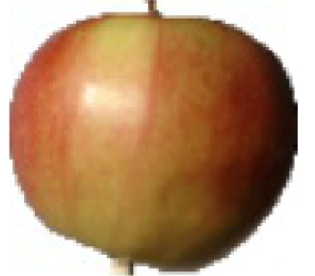
Problem
Identify the class of a fruit
Input image
Output class
Model
Fruit class

Slide 3
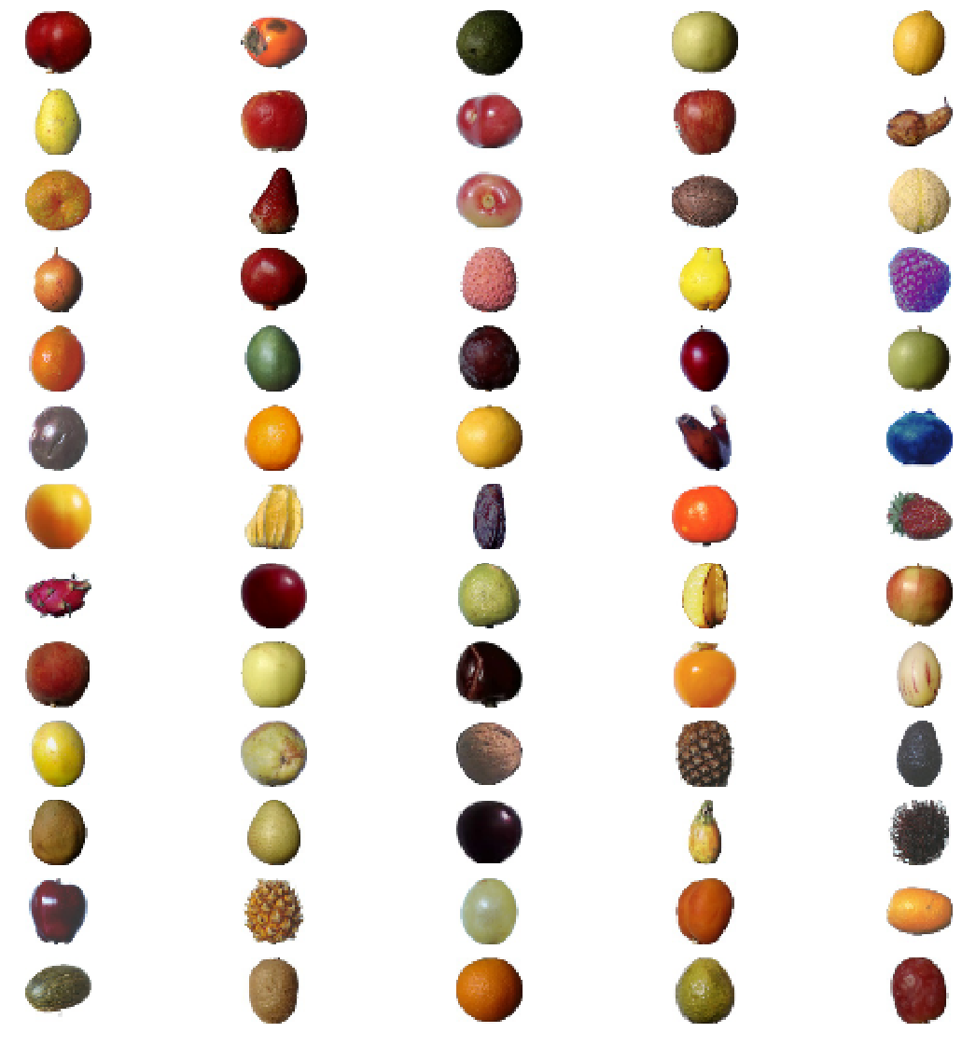
Data
Images of 75 different classes of fruits.
Around 50,000 images in total.
Image size = 100 x 100

Slide 4
Problem
Why do we care?
Potential mobile application where users take pictures of food and calorie’s for that specific fruit are calculated.
Mobile application where users want to find the name of an unknow fruit.
Use for automated fruit sorting by grocery stores
A potential template for other image classification tasks.
No GPU:
Kaggle’s kernel with GPU support is used for this analysis
Input image
Model
Output class
Fruit class

Slide 5
Data preparation
Original data
2 folders : Training and validation
Split data
3 folders: Training, validation and test folders
75%
25%

Slide 6
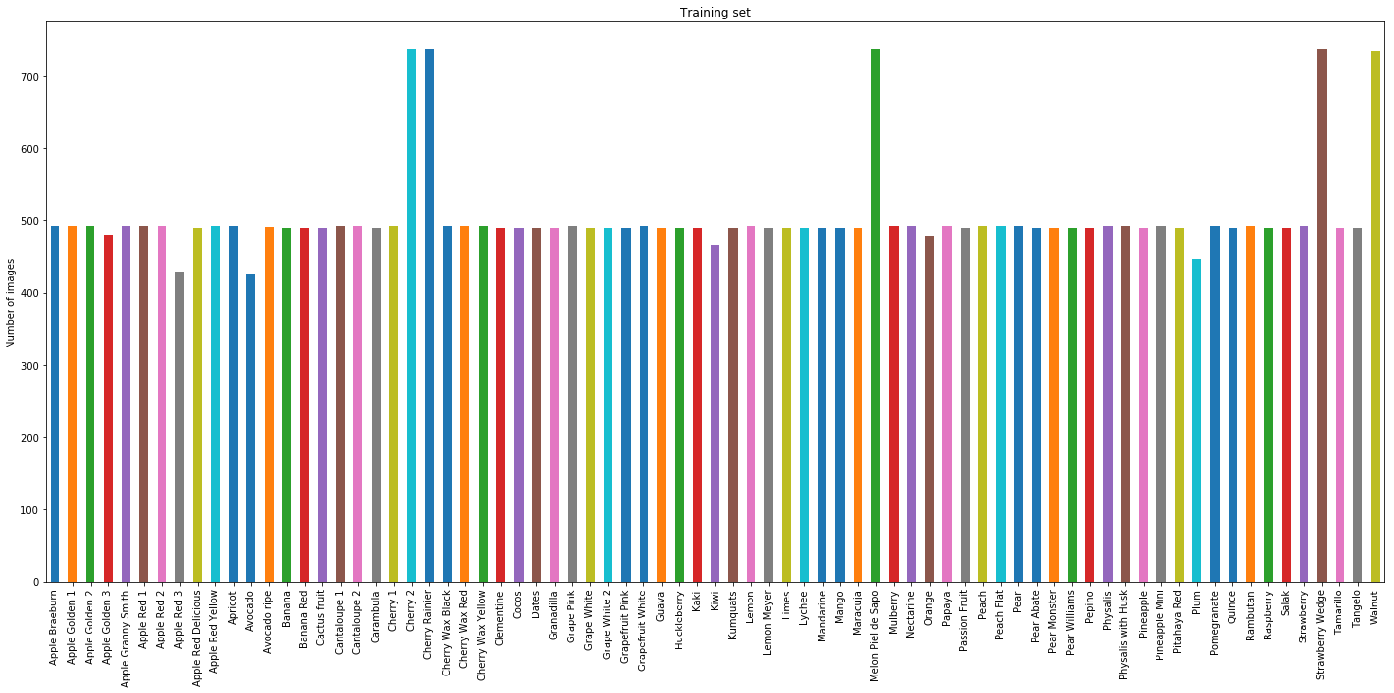
In the training set there are approximately 500 images for each class with a few exceptions.

Slide 7
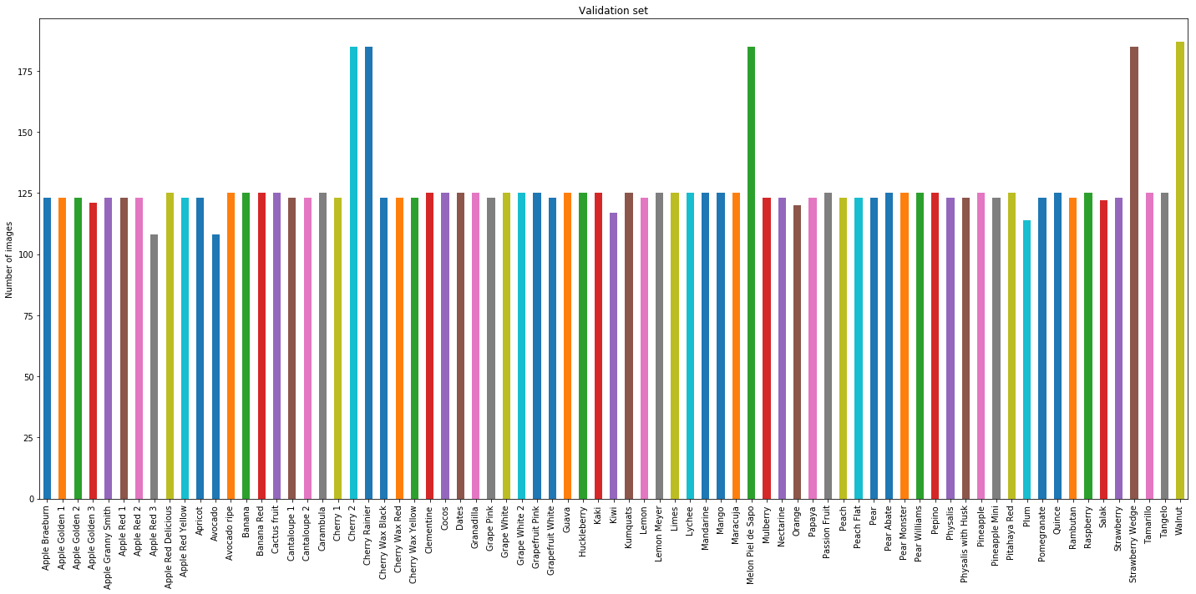
In validation set there are approximately 125 images for each class with a few exceptions.

Slide 8
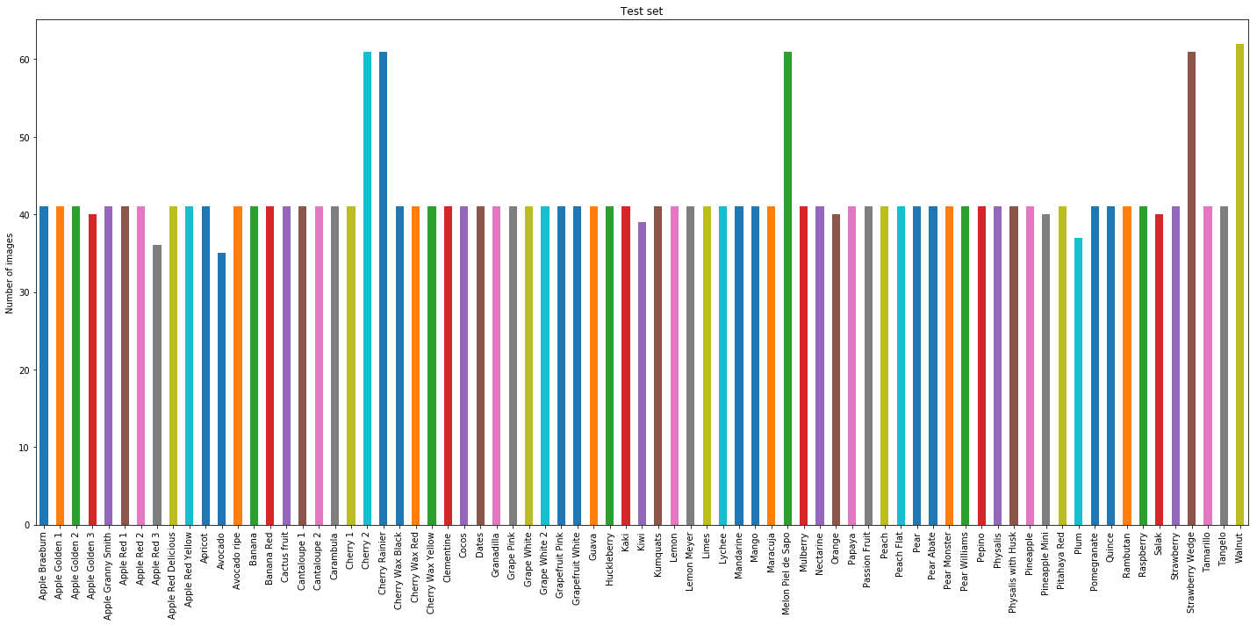
In the test set there are approximately 40 images for each class with a few exceptions.

Slide 9
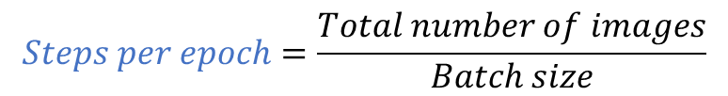
Summary of data and parameter calculation
Number of training images = 37836 , Batch size = 18
Number of validation images = 9554, Batch size = 17
Number of test images = 3155
Number of classes = 75 (Output size of the last layer of CNN)
$$Steps per epoch=\frac{Total number of images}{Batch size}$$

Slide 10
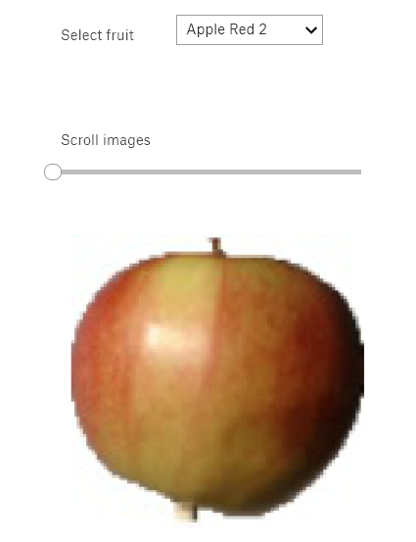
Interactive widget for data exploration
https://www.kaggle.com/rehanali88/kaggle-for-deep-learning-p-2-visualization-eda/output

Slide 11
Model1 architecture
Input shape = 100 x 100 x 3.
Output shape = 75
4 pairs of Convolution layer + maximum pooling layer.

Slide 12
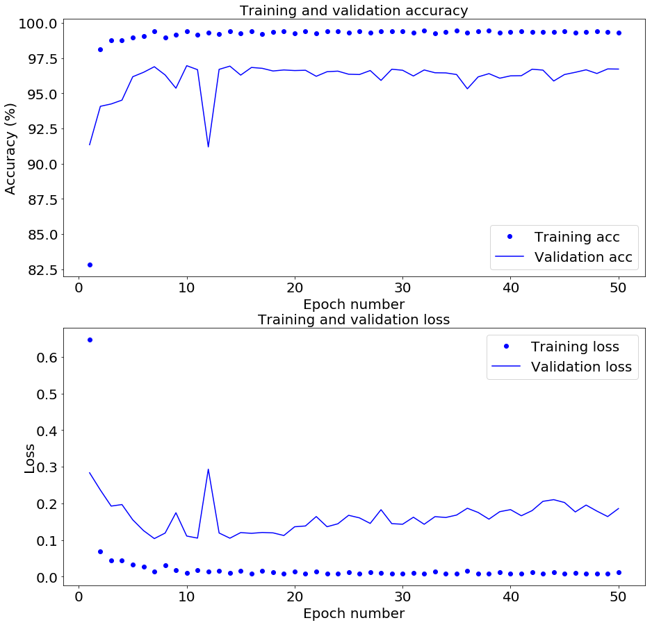
Model 1 evaluation
Validation loss shows a slight but steady increase as epoch number increases along with high variability.
Validation loss and accuracy never reach the values close to training loss and accuracy.
Might be overfitting the data.

Slide 13
Modifications for model 2
Modification in model architecture: Addition of a drop out layer. This layer randomly removed half the values from the previous layer. The aim is to make sure that the model does not learn non-specific patterns.
Modification of the training data: Data augmentation. Transformations , such as image rotation, image shear, image shift etc., of training images. The aim is to reduce the probability of the network to encounter the same image twice.

Slide 14
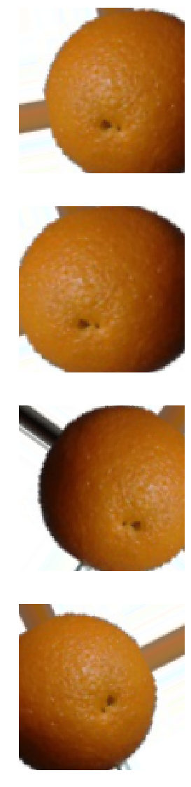
Data augmentation in action

Slide 15
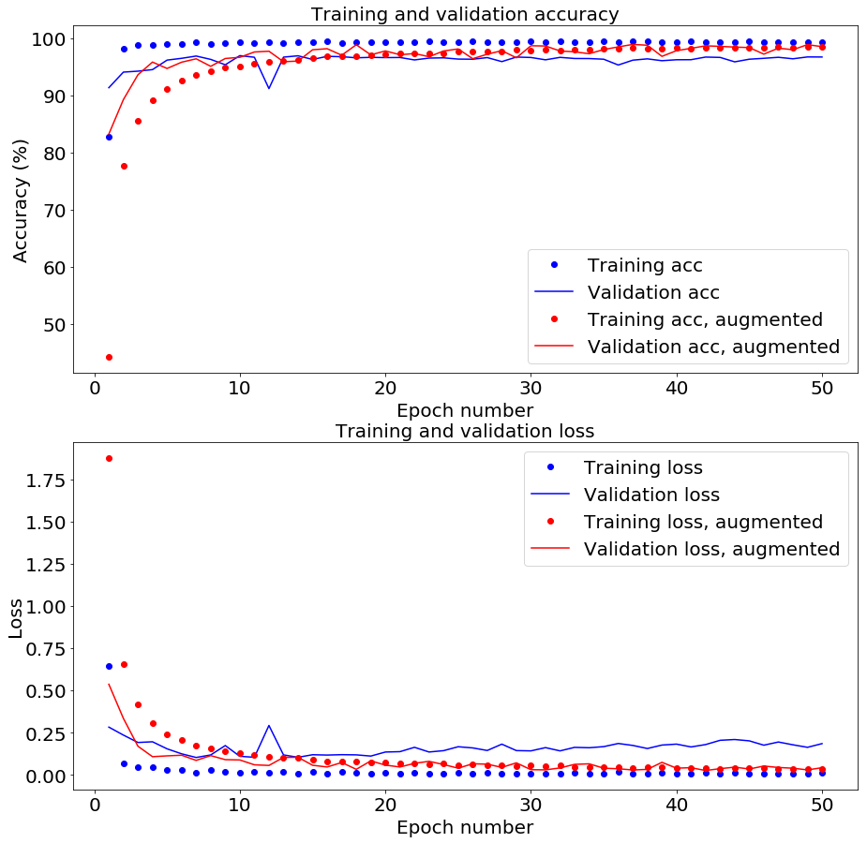
Model 1 vs. Model 2
Validation loss DOESNOT show an increase as epoch number increases. Also, it has low variability.
Validation loss and accuracy reach values close to training loss and accuracy.
No overfitting of the data.

Slide 16
Accuracy of models on test data
Model 1: Provides an accuracy of 96.7 % on the test data.
Model 2: Provides an accuracy of 98.6 % on the test data.
Summary
Convolution neural network predicts the class of a fruit with 98.6 % accuracy.
Useful template for other image classification tasks.
Demonstration of usage of Kaggle’s kernel with GPU.

